Slide 1




Data-Limited Fisheries Toolkit
Evaluating management strategies for data-limited fish species
Robustness testing and MP selection
Lecture 6a, May 2017
Tom Carruthers & Adrian Hordyk .
Nicolas Gutierrez

Slide 2
Agenda
MP selection by satisficing
Quality of data
Fishing efficiency
Implementation error
Gaining confidence in a management system

Slide 3
Operating models, the reference set vs the robustness set.
Reference set
Plausible
Estimated by assessment
Seen as the ‘first cut’ in MP selection
Robustness set
Less certain
Speculative
For ‘thinning the herd’ in MP selection
Punt et al. 2014. MSE Best practices.

Slide 4
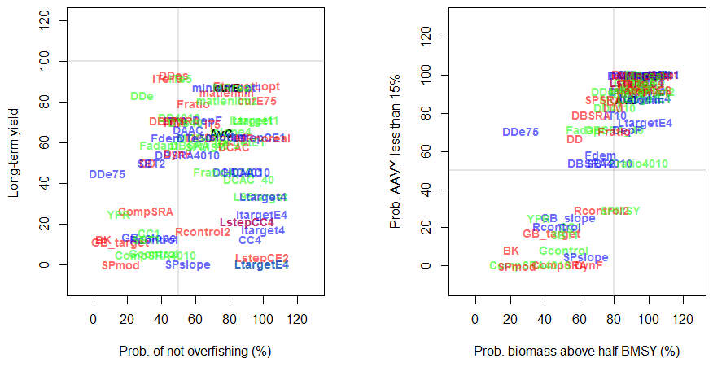
An example using the red snapper OM
LTY > 70 AND P50 > 80

Slide 5
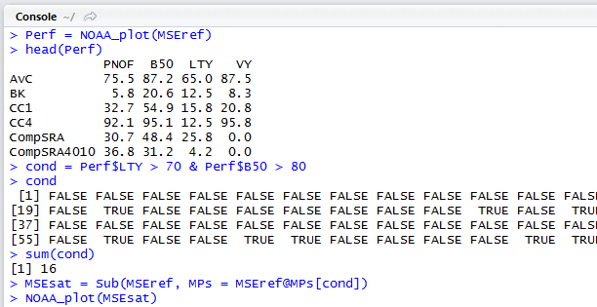
Joint satisficing using Sub() function
Record NOAA performance table
Take a look at the top of the table
Create satisficing condition
< Keep MP? >
Number of MPs that made the cut
Use Sub() function to subset MSE
Re-plot the satisficed MPs

Slide 6
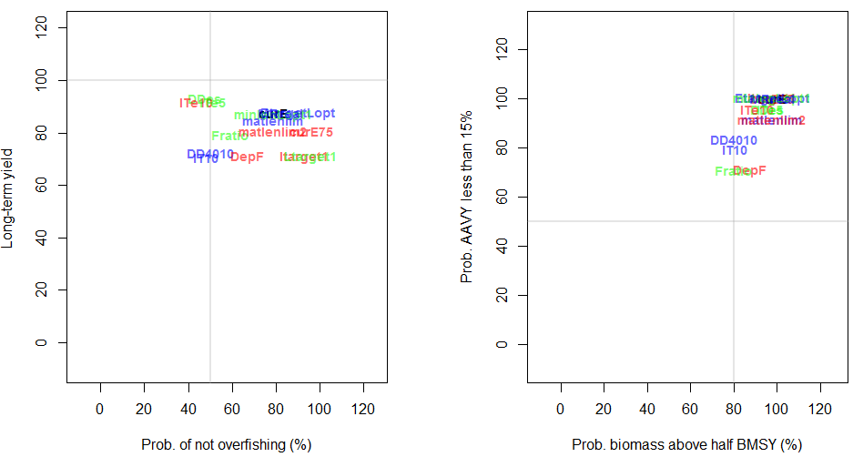
Satisficed MPs

Slide 7
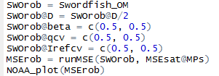
Robustness conditions
Consultation with ‘the group’ reveals that the foremost concern relates to the use of CPUE indices that may be hyperstable (i.e. that stay stable as the population declines).
To address this a robustness set of simulations is specified:
Copy operating model
Stock status around half
Hyperstable index
Uncertain catchability
Uncertain index target
Run Robustness MSE
Plot results

Slide 8
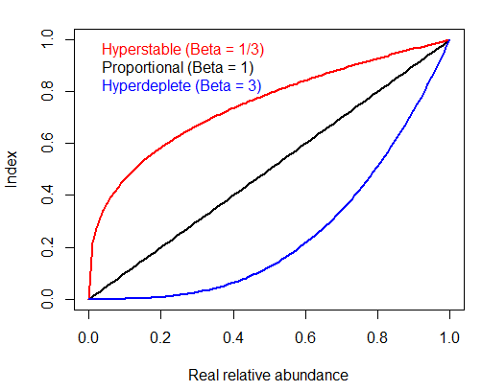

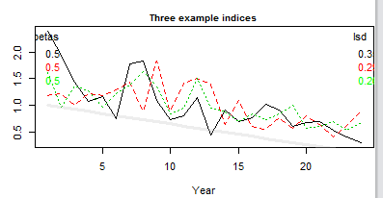
Hyper stability

Slide 9
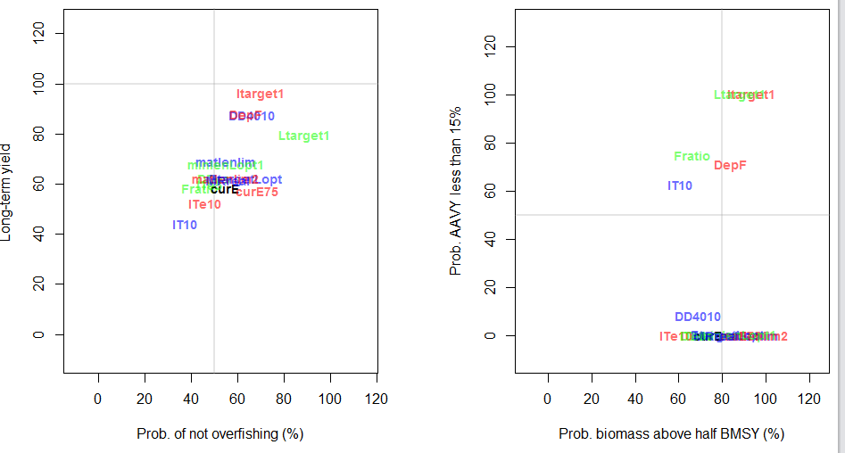
Robustness results
Only 3 MPs survived robustness testing according to original satisficing requirements: Itarget1, Ltarget1 and DepF.

Slide 10
Fishing efficiency
A central difference between input and output controls is the assumption that fishing effort can be predictably related to fishing mortality rate.
In other words that roughly the same fraction of the stock harvested per unit of effort.
If this isn’t true then a discrepancy could emerge between input and output control MPs…

Slide 11
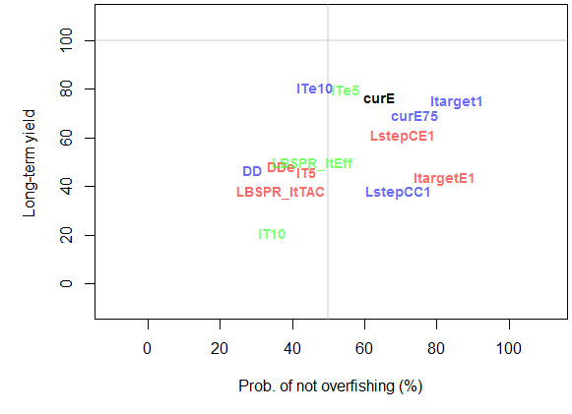
Effect of fishing efficiency increases
Generic Albacore OM: 0.0% pa efficiency gains

Slide 12
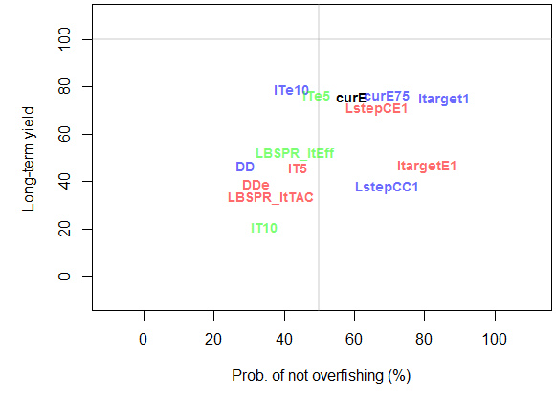
Effect of fishing efficiency increases
Generic Albacore OM: 0.5% pa efficiency gains

Slide 13
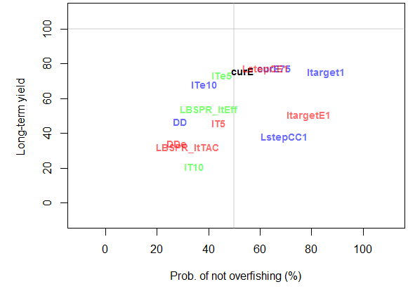
Effect of fishing efficiency increases
Generic Albacore OM: 1.0% pa efficiency gains

Slide 14
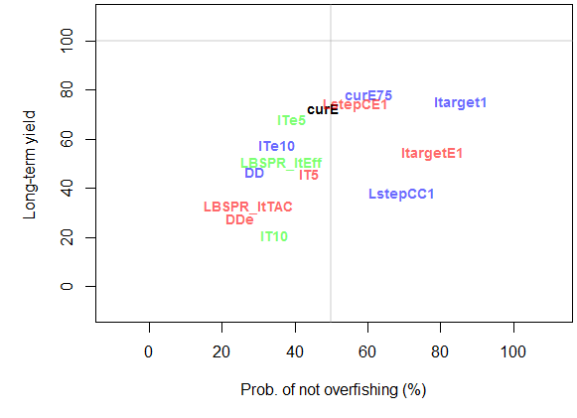
Effect of fishing efficiency increases
Generic Albacore OM: 1.5% pa efficiency gains

Slide 15
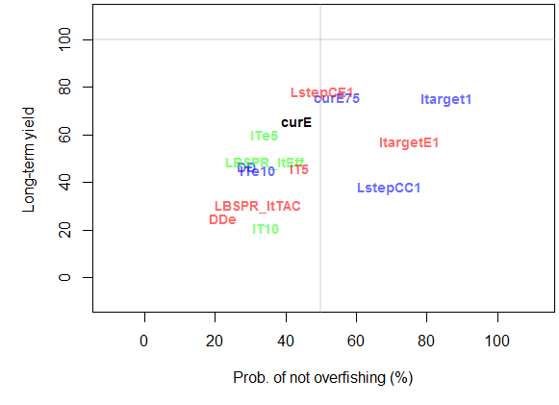
Effect of fishing efficiency increases
Generic Albacore OM: 2.0% pa efficiency gains

Slide 16
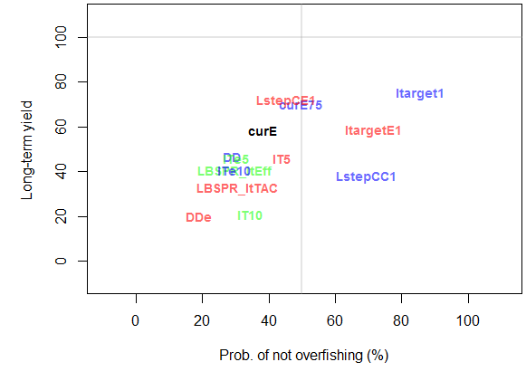
Effect of fishing efficiency increases
Generic Albacore OM: 2.5% pa efficiency gains

Slide 17
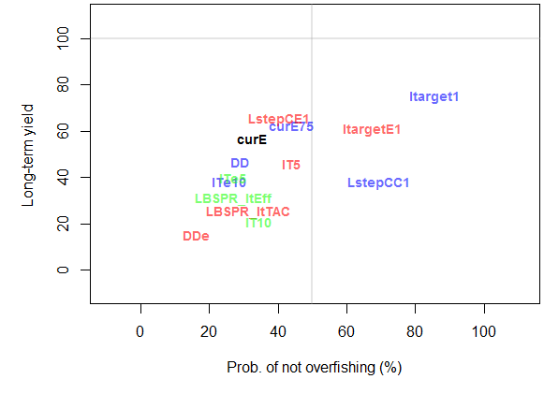
Effect of fishing efficiency increases
Generic Albacore OM: 3.0% pa efficiency gains

Slide 18
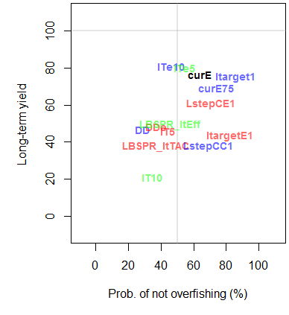
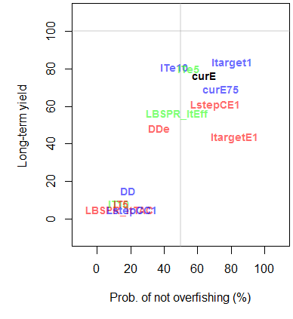
20% overages in TACs and TAEs
20% overage in TAE 20% overage in TAC

Slide 19
Handy commands
Subset an MSE Sub(myMSE, MPs)

